Slide 1
PWM Signals – Up to one per CCR
CCR0 sets the time period
0xFFFF
TA0CCR0
TA0CCR1
TA0CCR2
0x0
OUT1
CCRn sets duty cycle
Duty cycle (“on” time ) is set by selecting Output Mode and varying CCRx value
In this example, CCR0 – CCR1 = amount of time Signal is High

Slide 2
PWM Signals – Up to one per CCR
0xFFFF
TA0CCR0
TA0CCR1
TA0CCR2
0x0
OUT1
OUT2
Duty cycle (“on” time ) is set by selecting Output Mode and varying CCRx value
In this example, CCR0 – CCR1 = amount of time Signal is High

Slide 3
The ADC10 block diagram is shown in Figure.

Slide 4
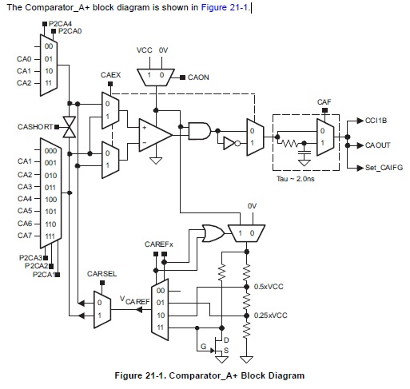

Slide 5
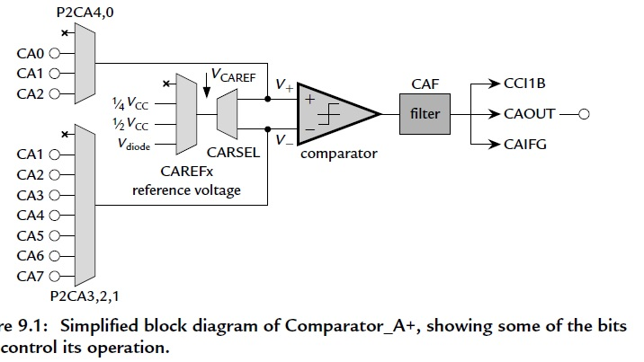

Slide 6
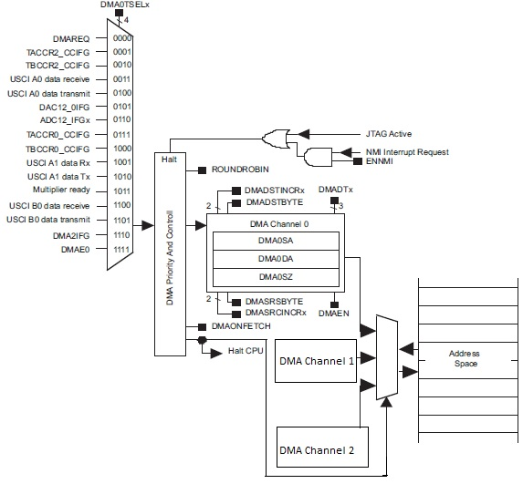
The DMA controller block diagram is shown in Figure.

Slide 7
Remote Controller of Air Conditioner Using MSP430
System Description:
This board demonstrates an ultra-low power, general purpose, infrared remote controller solution.
The board uses a FRAM-based MCU MSP430FR4133, which supports features such as real time clock, button scan, infrared encoding, LED backlight, and LCD display.
MSP430FR4133:
The features of MSP430FR4133 are
16-bit RISC architecture up to 16 Mhz
Wide supply voltage range from 1.8 V to 3.6 V
64-Pin/56-Pin/48Pin TSSOP/LQFP package options
Integrated LCD driver with charge pump can support up to 4x36 or 8x32 segment LCD

Slide 8
Optimized 16-bit timer for infrared signal generation
Low power mode (LPM3.5) with RTC on:0.77 uA
Low power mode (LPM3.5) with LCD on: 0.936 uA
Active mode: 126 uA/MHz
10^15 write cycle endurance low power ferroelectric RAM (FRAM) can be used to store data
10-channel, 10-bit analog-to-digital converter (ADC) with built-in 1.5 V reference for battery powered system
All I/Os are capacitive touch I/O

Slide 9
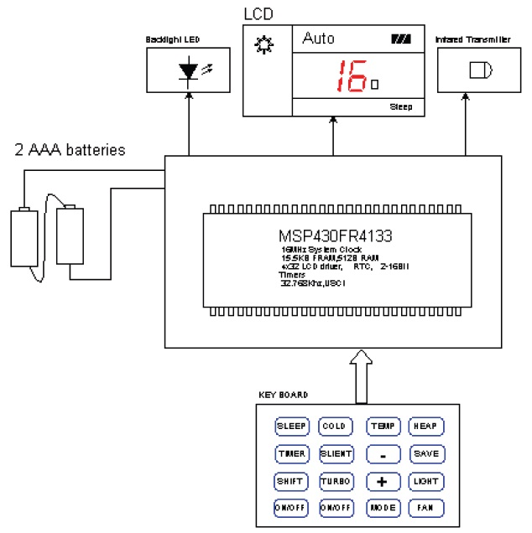
Circuit Design

Slide 10
A 4x28 segment LCD is directly connected to the MSP430FR4133 LCD driver pins.
A 4x4 matrix is used to detect 15 buttons. The matrix columns are connected to interrupt-enabled GPIOs (P1) to wake up the MSP430FR4133 from low power mode.
MCU internal pull up/pull down resistors are used as button scan matrix pull up resistors. No external resistor is needed for button detection, and no external circuit is needed for battery voltage detection.
A 32.768 KHz watch crystal serves as the MCU FLL and RTC clock source.
Two chip capacitors, C4 and C6, are used as the crystal loading capacitor. Designers must choose C4 and C6 values carefully
according to crystal specification.

Slide 11
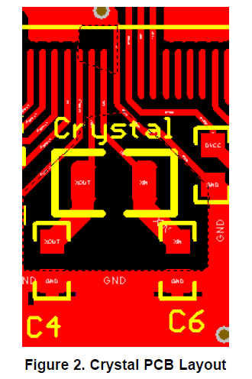

Slide 12
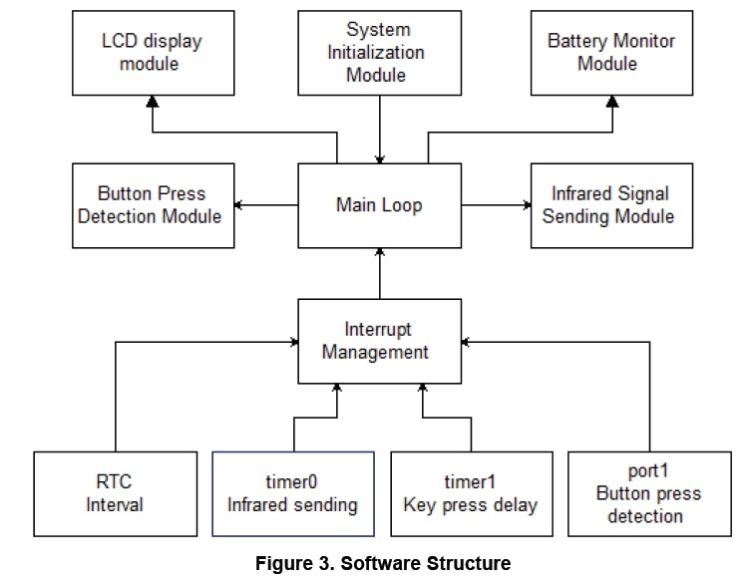
Software Description:

Slide 13
The software implements an interrupt-driven structure. In the main loop, the MCU stays in LPM3.5 mode.
Interrupts from the button, RTC, and timer wake up the MCU for task processing.
Inputs from the button are processed in task Key Process (), which handles system status and generates the content for the LCD
display and infrared signal.
RTC generates a 3S interval interrupt to inform the system of battery voltage measurement.

Slide 14
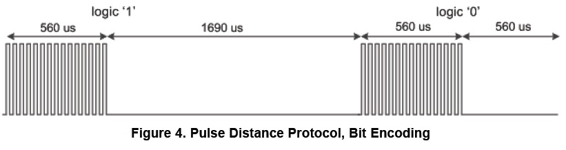
Infrared Signal Generation:
There are several kinds of infrared modulation protocols in the industry. This design illustrates pulse distance protocol with data frame format, the most commonly-used format for air conditioner remote controllers.
The space’s width distinguishes logic 1 and logic 0 respectively. The carrier-modulated pulse width is constant.
In this design, space length for 1 is 1690 uS, and 560 uS for digit 0. Modulated pulse width is 560 uS.

Slide 15
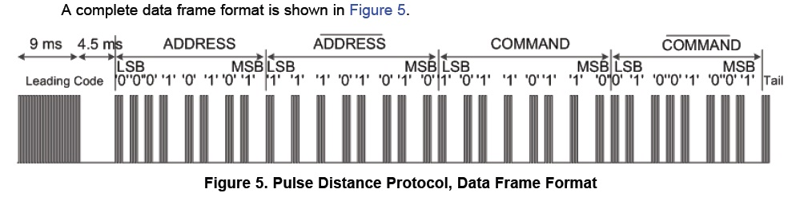
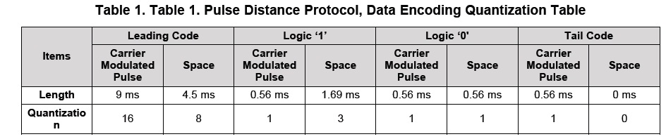

Slide 16
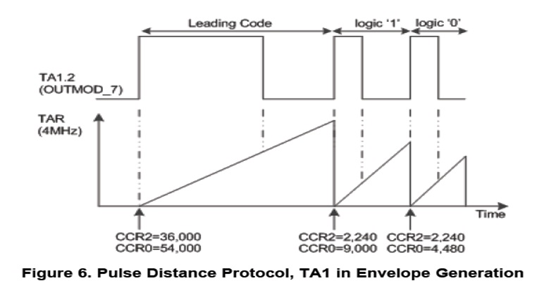
TA1 is used to generate an envelope waveform, and each pair of carrier-modulated pulse and space must update the CCR0 and CCR2 once.
The CCR0 depends on the carrier-modulated pulse period plus the space period, while the CCR2 depends on the carrier-modulated pulse period.

Slide 17
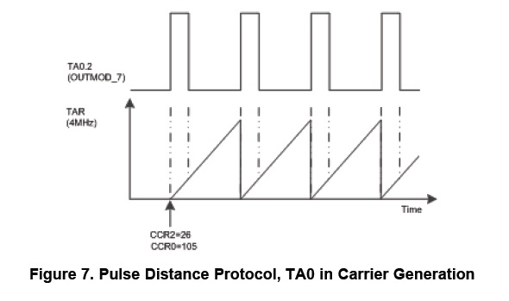
To generate 38 kHz carrier with ¼ duty, CCR0 and CCR2 of TA0 are configured according to SMCLK. For example, with a 4 MHz SMCLK, CCR0 and CCR2 are individually configured to be 105 (4,000/38) and 26 (4,000/38/4). Figure 7 shows how the duty setting works.

